Slide 1
Secure Your Home with the Motion Detector Alarm Circuit
Course Teacher: Dr. A. A Mohammad Monzur-Ul-Akhir
Department of Electrical and Electronic Engineering
SL # | Students ID | Students Name | Program
1 | 22-46207-1 | Rafsan Mahmud | BSc in CSE
2 | 22-46229-1 | Ishtiak Billah Emon | BSc in CSE
3 | 22-46903-1 | Nil Akondo | BSc in CSE
4 | 22-46884-1 | Nour Nahar Priyali | BSc in CSE
5 | 22-47081-1 | Samanta Mehnaj | BSc in CSE

Slide 2


Outline of the Presentation
Objectives
Introduction
Research/Working Method
Description of the Work
Results and Discussions
Conclusions
Future Works

Slide 3
Objective
Objectives of the Work
Demonstrating how the circuit can be easily built and installed, providing a DIY solution for home security.
Explaining the importance of incorporating such a security system as a part of a comprehensive security plan.
Showcasing the potential future scope of the technology, such as incorporating wireless connectivity, integrating with other security systems, using machine learning and AI, and improving energy efficiency.
Addressing common concerns or questions that people may have about the circuit, such as its effectiveness, range, and battery life.
Providing tips and recommendations on how to optimize the circuit's performance and ensure its longevity.

Slide 4
Introduction
BACKGROUND STUDY:
Researching the current state of home security systems and the range of available options, from traditional alarm systems to DIY solutions.
Examining statistics on the prevalence of burglaries and break-ins, and the resulting property damage, injuries, or fatalities.
Exploring the emotional toll on victims of home invasions, as well as the financial cost of property loss.
Investigating common concerns and misconceptions about home security systems, such as their cost, complexity, and effectiveness.

Slide 5
Introduction
Motivation:
Raising awareness of the importance of home security systems and the potential risks of not having a reliable system in place.
Offering an affordable and accessible solution for homeowners who may be hesitant to invest in a more complex or expensive security system.
Providing peace of mind to homeowners who may feel vulnerable to potential break-ins or theft.
Addressing common concerns and misconceptions about home security systems and showing how the Motion Detector Alarm Circuit can offer a simple, effective, and affordable solution.
Highlighting the potential for future advancements in the technology and its integration with other security systems, making it an even more powerful tool for home security.

Slide 6
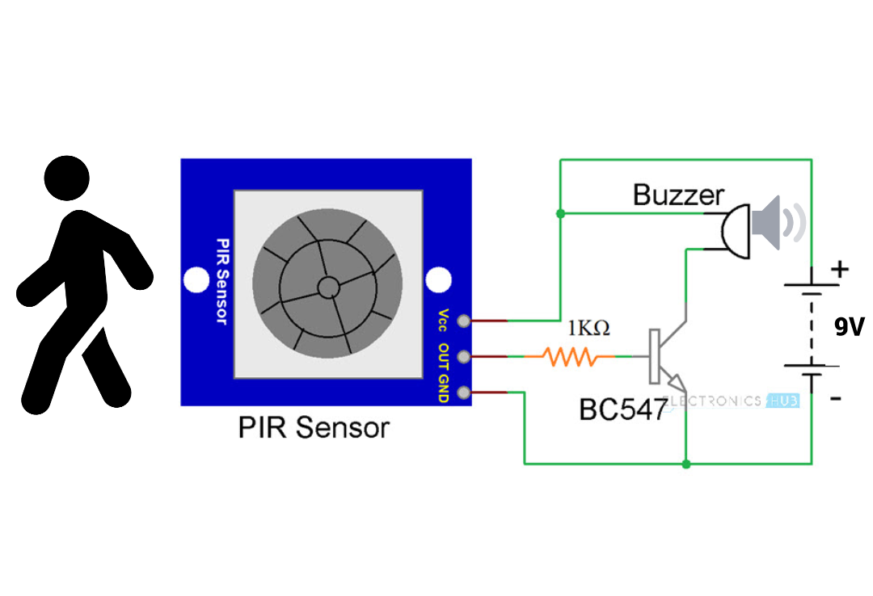
Working Method
A motion detector alarm circuit is a type of security system that uses a motion sensor to detect movement and trigger an alarm. Here's a general overview of how it works:
Motion sensor: The motion sensor is typically a passive infrared (PIR) sensor that detects changes in the infrared radiation levels in its field of view. When a moving object enters the sensor's field of view, the infrared radiation levels change, and the sensor detects this change.
Sensor output: When the motion sensor detects movement, it sends a signal to the alarm circuit.
Alarm circuit: The alarm circuit is a simple electronic circuit that consists of a few components, including a power source, a timer, an amplifier, and a speaker. When the motion sensor sends a signal to the alarm circuit, the timer starts counting down.
Amplifier: The output from the timer is then amplified by an amplifier circuit to drive a speaker, which produces a loud sound.
Reset: After the alarm has been triggered, the circuit needs to be reset before it can detect motion again.
In summary, a motion detector alarm circuit works by using a motion sensor to detect movement, which triggers a simple electronic circuit to produce a loud alarm sound. The circuit is reset using a switch before it can detect motion again.

Slide 7
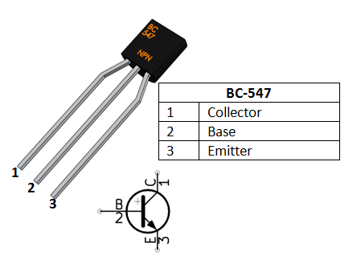
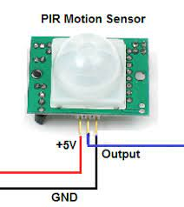
Equipment's
SL NO. | Components | Models | Quantity
1 | Transistor | Bc547 | 1
2 | Passive infrared sensor | Motion sensor | 1
3 | Battery 9V |  | 1
4 | Active Buzzer |  | 1
5 | Resistor | 1k ohm | 1
6 | Breadboard | 400 Point | 1
7 | Diode | 1n4007 | 1
8 | Some weirs |  | 1
9 | 9V Battery Connector |  | 1

Slide 8
Description/Methodology of the Work
BC-547 Transistor:
The BC547 transistor is a general-purpose NPN transistor used for amplification and switching in electronic circuits.
It consists of three pins: the base, collector, and emitter.
When a voltage is applied to the base pin, it allows current to flow through the collector and emitter pins.
The amount of current flowing through the collector and emitter pins is controlled by the voltage applied to the base pin.
This voltage can be used to amplify a signal or to turn the transistor on and off rapidly for switching purposes.
The BC547 transistor is commonly used in audio amplifiers, signal processing circuits, and other applications where low-power amplification or switching is needed.
It is a versatile and widely used component in electronics and is an essential part of any circuit designer's toolkit.
The BC547 transistor is used in this project to amplify the signal from the motion sensor and to switch on and off the speaker-based detection of motion. The 1KΩ resistor connected to the base pin of the transistor ensures that the voltage to the base remains within safe limits, preventing damage to the transistor. This simple project the use of the BC547 transistor in motion sensing applications. demonstrates

Slide 9
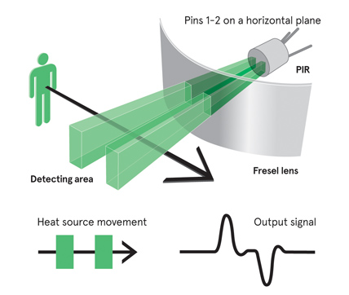
Description/Methodology of the Work
PIR stands for Passive Infrared Sensor. It is a type of motion sensor that detects the infrared radiation emitted by living beings and objects.
They consist of a pyroelectric sensor that detects changes in the infrared radiation in its field of view.
The pyroelectric sensor generates a voltage when there is a change in the infrared radiation, which is then amplified and processed by the sensor's electronic circuitry.
PIR sensors have a limited range and are most effective in detecting motion within a range of a few meters.
They are passive, meaning they do not emit any energy to detect motion, making them energy-efficient and safe to use.
PIR sensors have two sensing elements that are sensitive to changes in the infrared radiation. The two elements are used to detect the movement of a warm object and to eliminate false alarms caused by changes in ambient temperature or light.
PIR sensors have a time delay feature that ensures the sensor is not triggered by false alarms caused by brief movements or changes in temperature or light.

Slide 10
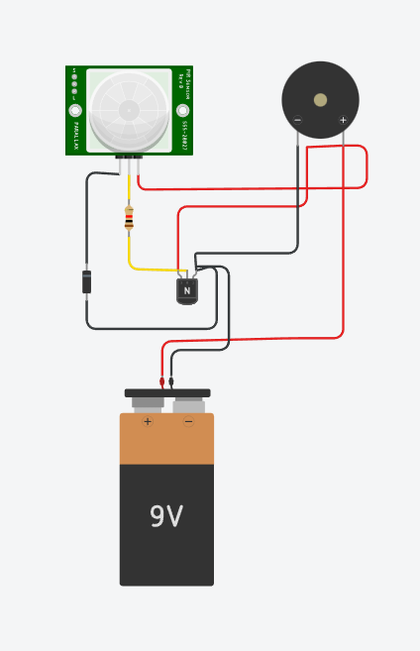
Description/Methodology of the Work
Connect the PIR motion sensor module to the breadboard and connect the positive (+) and negative (-) pins to a power source.
Connect the signal pin of the PIR motion sensor module to the base pin of the BC547 transistor.
Connect a 1KΩ resistor from the base pin of the transistor to the ground (GND) pin of the breadboard.
Connect the collector pin of the transistor to the positive (+) terminal of a speaker and the negative (-) terminal of the speaker to the ground (GND) pin of the breadboard.
Connect a diode (1N4007) in reverse bias between the positive (+) and negative (-) terminals of the power source.
When motion is detected by the PIR motion sensor, it sends a signal to the base pin of the transistor, which allows current to flow through the collector and emitter pins of the transistor.
Figure: Circuit diagram

Slide 11
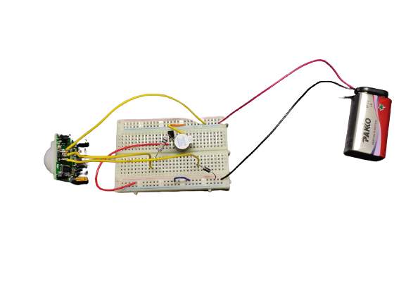
Description/Methodology of the Work
This current activates the speaker, which indicates that motion has been detected.
The diode in reverse bias protects the circuit from damage caused by reverse voltage, which can occur if the power source is connected incorrectly.
The BC547 transistor is used in this project to amplify the signal from the motion sensor and to switch on and off the speaker based on the detection of motion. The 1KΩ resistor connected to the base pin of the transistor ensures that the voltage to the base remains within safe limits, preventing damage to the transistor. The diode in reverse bias protects the circuit from damage caused by reverse voltage. This simple project demonstrates the use of the BC547 transistor and diode in motion sensing applications.
Figure: photo of project

Slide 12
Future Scopes
Wireless connectivity: One potential future scope for the Motion Detector Alarm Circuit is to incorporate wireless connectivity to enable the user to monitor and control the alarm remotely. This could be done by integrating Wi-Fi or Bluetooth modules into the circuit, allowing the user to receive notifications and control the alarm using a smartphone or other smart device.
Integration with other security systems: Another future scope for the Motion Detector Alarm Circuit is to integrate it with other security systems, such as CCTV cameras, door locks, and smart home systems. This could enable the user to create a more comprehensive and sophisticated security system that is capable of detecting, alerting, and responding to potential intrusions.
Machine learning and AI: The integration of machine learning and artificial intelligence (AI) could be a future scope for the Motion Detector Alarm Circuit. By analyzing data from the motion sensor and other sensors, an AI system could learn to identify patterns of behavior and predict potential intrusions before they occur. This could greatly enhance the effectiveness and efficiency of the security system.
Energy efficiency: A future scope for the Motion Detector Alarm Circuit is to improve its energy efficiency by using low-power components and optimizing the circuit design. This would extend the battery life of the circuit, reducing the need for frequent battery replacements.
Overall, the future scope of the Motion Detector Alarm Circuit includes integrating it with other security systems, incorporating wireless connectivity, using machine learning and AI, and improving energy efficiency. These advancements could make the system more effective, efficient, and convenient for users.

Slide 13
Conclusions
In conclusion, the Motion Detector Alarm Circuit is a simple yet effective electronic security system that uses a motion sensor to detect motion and trigger an alarm to alert the user of potential intruders. The circuit includes components such as a power supply, motion sensor, amplifier, timer, speaker, and reset switch.
The motion detector alarm circuit is easy to build and install, making it a popular choice for home security systems. It can detect motion in its range and produce a loud alarm sound to alert the user. The circuit can be reset using the reset switch once the alarm has been triggered.
The future scope of the Motion Detector Alarm Circuit includes incorporating wireless connectivity, integrating with other security systems, using machine learning and AI, and improving energy efficiency. These advancements could greatly enhance the effectiveness and convenience of the system, making it an even more valuable tool for ensuring the safety and security of homes and other premises.
Overall, the Motion Detector Alarm Circuit is a useful and effective security system that can help deter potential intruders and provide peace of mind for users.

Slide 14

Thanks for listening our presentation

